Slide 1
Fill in the

Slide 2
Fill in the ?
What goes in the blank?

Slide 3
The Greatest Commandment
The first is first for a reason

Slide 4
The Greatest Commandment
The first is first for a reason
You cannot truly be fulfilling the first without authentic expression of the second

Slide 5
Who’s your neighbor?
Anyone with whom you come in contact or have influence

Slide 6
But he, desiring to justify himself, said to Jesus, “And who is my neighbor?”
Luke 10:29 (ESV)

Slide 7
But a Samaritan, as he journeyed, came to where he was, and when he saw him, he had compassion.
Luke 10:33 (ESV)

Slide 8
We love because he first loved us.
1 John 4:19 (ESV)

Slide 9
If anyone says, “I love God,” and hates his brother, he is a liar; for he who does not love his brother whom he has seen cannot love God whom he has not seen. ²¹ And this commandment we have from him: whoever loves God must also love his brother.
1 John 4:20–21 (ESV)

Slide 10
What is worship?
Worship is our effort in heart, soul, mind and strength; to honor, give glory and relate to the One whom all honor and glory is due – our Creator God.

Slide 11
Worship is a lifestyle

Slide 12
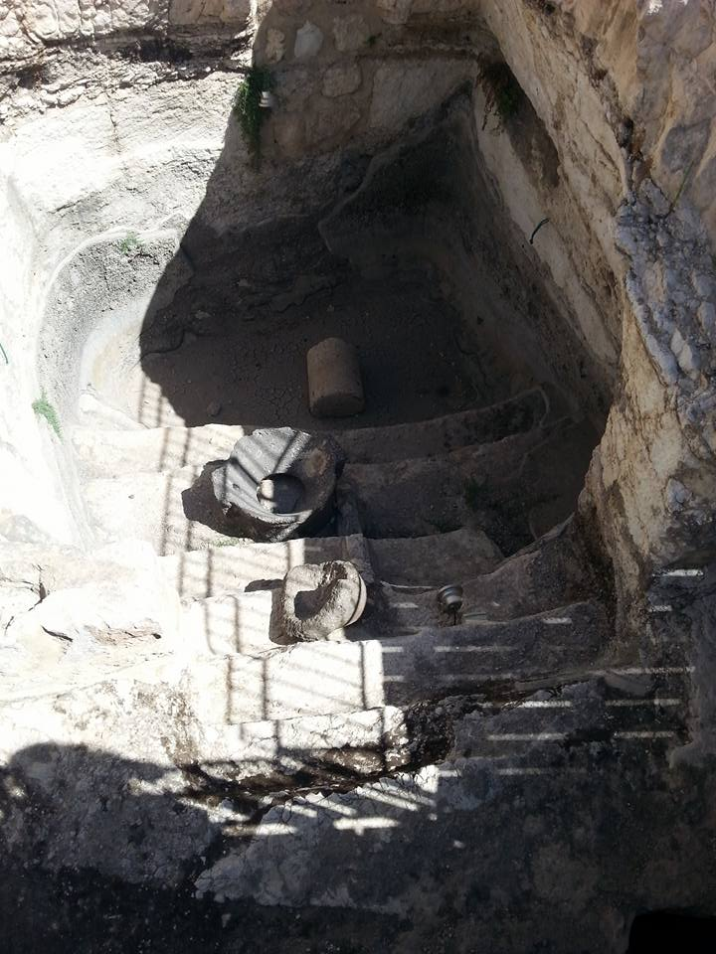

Slide 13
¹⁹ Or do you not know that your body is a temple of the Holy Spirit within you, whom you have from God? You are not your own, ²⁰ for you were bought with a price. So glorify God in your body.
1 Corinthians 6:19–20 (ESV)

Slide 14
¹ I appeal to you therefore, brothers, by the mercies of God, to present your bodies as a living sacrifice, holy and acceptable to God, which is your spiritual worship.
Romans 12:1 (ESV)

