Slide 1
Set Free
a study of Galatians

Slide 2
This is God’s Holy Word. Written by men, inspired by God. God gave it to us that we may understand all things pertaining to life and godliness. These Scriptures are not what save me but it is the One to whom they testify; that is, Jesus Christ. The Word of God is my authority in life. It is to shape my thinking and transform my life. I will learn it, live it and give it to those around me. Amen

Slide 3
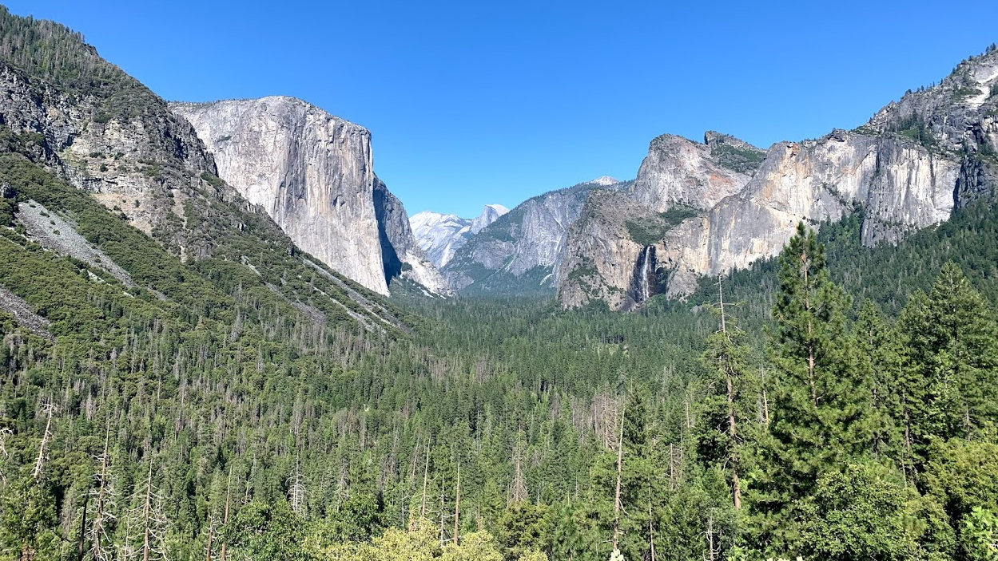

Slide 4
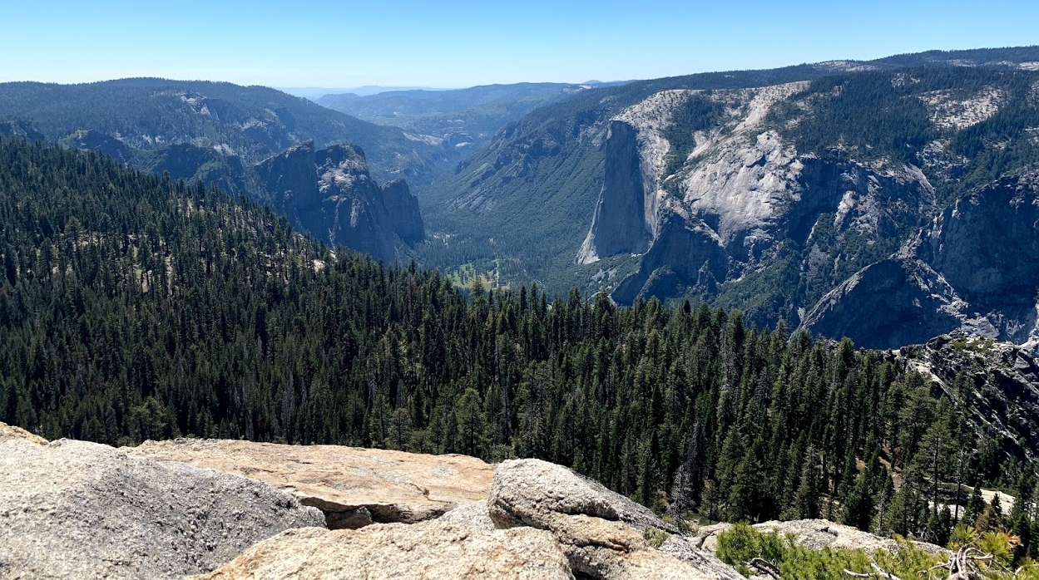

Slide 5
¹ Paul, an apostle—not from men nor through man, but through Jesus Christ and God the Father, who raised him from the dead— ² and all the brothers who are with me, To the churches of Galatia: ³ Grace to you and peace from God our Father and the Lord Jesus Christ, ⁴ who gave himself for our sins to deliver us from the present evil age, according to the will of our God and Father, ⁵ to whom be the glory forever and ever. Amen.
Galatians 1:1-5 (ESV)

Slide 6
⁶ I am astonished that you are so quickly deserting him who called you in the grace of Christ and are turning to a different gospel
Galatians 1:6 (ESV)

Slide 7
⁶ I am astonished that you are so quickly deserting him who called you in the grace of Christ and are turning to a different gospel— ⁷ not that there is another one, but there are some who trouble you and want to distort the gospel of Christ.
Galatians 1:6-7 (ESV)

Slide 8
Apostle = one sent out with a particular message by the initiation and authority of another

Slide 9
⁶ I am astonished that you are so quickly deserting him who called you in the grace of Christ and are turning to a different gospel— ⁷ not that there is another one, but there are some who trouble you and want to distort the gospel of Christ. ⁸ But even if we or an angel from heaven should preach to you a gospel contrary to the one we preached to you, let him be accursed. ⁹ As we have said before, so now I say again: If anyone is preaching to you a gospel contrary to the one you received, let him be accursed. ¹⁰ For am I now seeking the approval of man, or of God? Or am I trying to please man? If I were still trying to please man, I would not be a servant of Christ.
Galatians 1:6-10 (ESV)

Slide 10
“Christians are quick to encourage each other to ‘live out the gospel,’ to ‘be the gospel’ to our neighbors, and to even ‘gospel each other.’ The missional impulse here is helpful, yet the gospel isn't anything the Christian can live out, practice, or become. The Apostle Paul summarized the gospel as the life, death, and resurrection of Jesus Christ, through whom sin is atoned for, sinners are reconciled to God, and the hope of the resurrection awaits all who believe.

Slide 11
The gospel is not habit, but history. The gospel is the declaration of something that actually happened. And since the gospel is the saving work of Jesus, it isn't something we can do, but it is something we must announce. We do live out its implications, but if we are to make the gospel known, we will do so through words.”
(Ed Stetzer – The Exchange blog – June 25, 2012)

Slide 12
…I hold you in my heart, for you are all partakers with me of grace, both in my imprisonment and in the defense and confirmation of the gospel.
Philippians 1:7 (ESV)

Slide 13
The Gospel in Four Words
God
Sin
Jesus
Response

Slide 14
The Gospel in Four Words
God – Every right and full conversation about the gospel will eventually arrive at this point – God is the beginning.

Slide 15
The Gospel in Four Words
God – Every right and full conversation about the gospel will eventually arrive at this point – God is the beginning.
¹ In the beginning was the Word, and the Word was with God, and the Word was God. ² He was in the beginning with God. ³ All things were made through him, and without him was not any thing made that was made. ⁴ In him was life, and the life was the light of men. ⁵ The light shines in the darkness, and the darkness has not overcome it.
John 1:1–5 (ESV)

Slide 16
The Gospel in Four Words
Sin – It is the essence of our nature when conceived; we are made in the image of God but that image is deeply impacted by the presence of sin

Slide 17
The Gospel in Four Words
Jesus – the only way for reconciliation

Slide 18
The Gospel in Four Words
Response – based on faith, not action
Romans 10:8–9 (ESV) - ⁸ But what does it say? “The word is near you, in your mouth and in your heart” (that is, the word of faith that we proclaim); ⁹ because, if you confess with your mouth that Jesus is Lord and believe in your heart that God raised him from the dead, you will be saved.
Ephesians 2:8–9 (ESV) - ⁸ For by grace you have been saved through faith. And this is not your own doing; it is the gift of God, ⁹ not a result of works, so that no one may boast.

