Slide 2
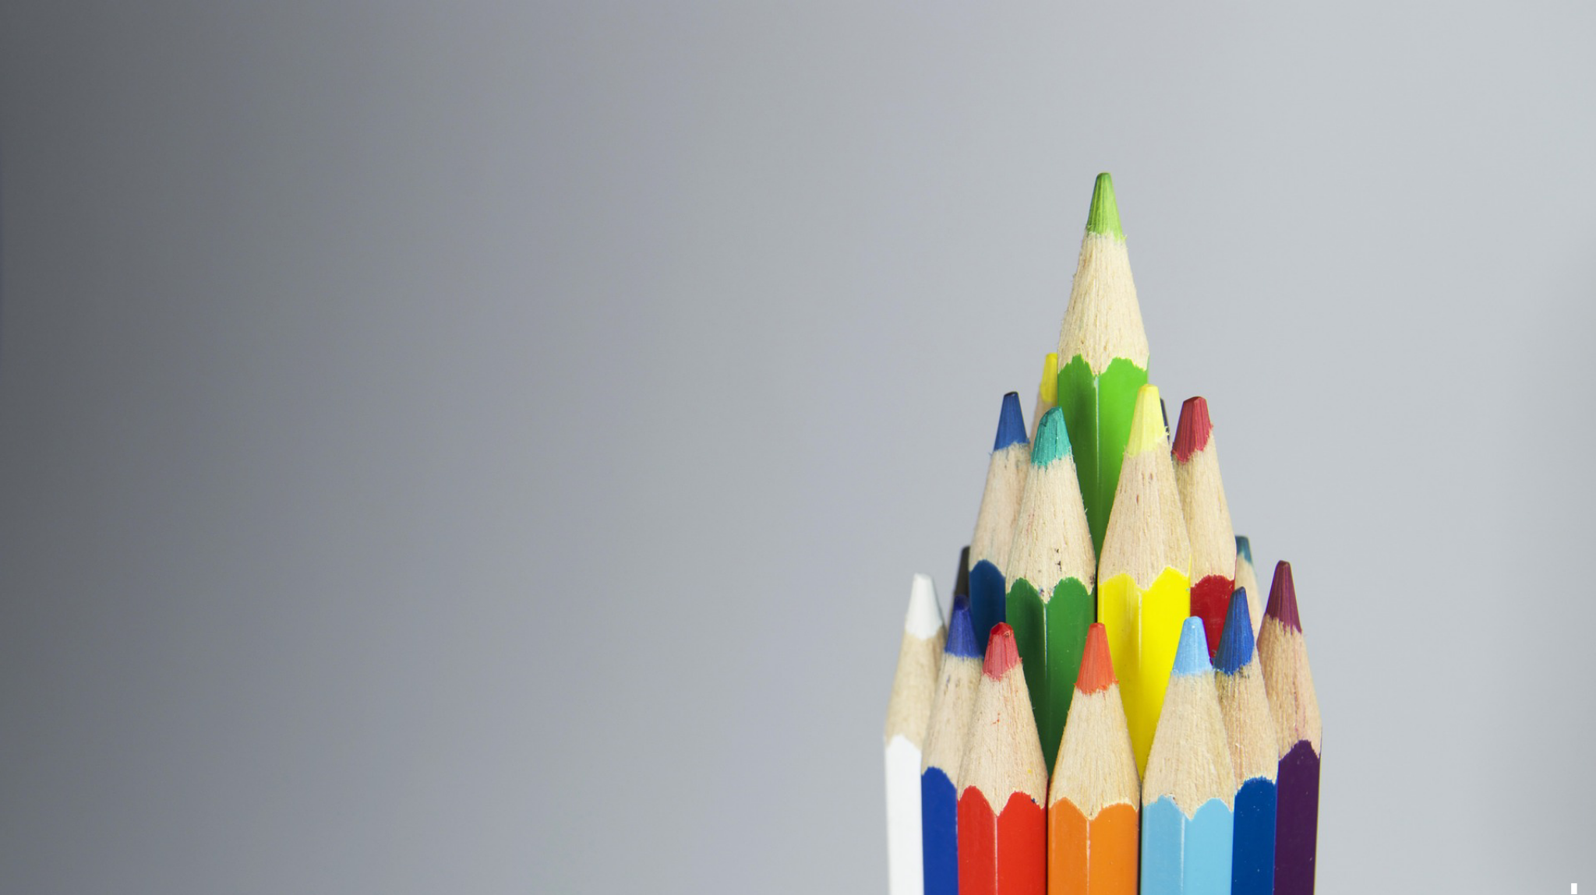
What is your favorite Thanksgiving food?

Slide 3
Matthew 12:34
Out of the overflow of the heart the mouth speaks

Slide 4
Genesis 3:1-7
Now the serpent was more crafty than any other beast of the field that the Lord God had made. He said to the woman, “Did God actually say, ‘You shall not eat of any tree in the garden’?” ² And the woman said to the serpent, “We may eat of the fruit of the

Slide 5
Genesis 3:1-7
trees in the garden, ³ but God said, ‘You shall not eat of the fruit of the tree that is in the midst of the garden, neither shall you touch it, lest you die.’ ” ⁴ But the serpent said to the woman, “You will not surely die. ⁵ For God knows that when you eat of it your eyes

Slide 6
Genesis 3:1-7
will be opened, and you will be like God, knowing good and evil.” ⁶ So when the woman saw that the tree was good for food, and that it was a delight to the eyes, and that the tree was to be desired to make one wise, she took of its fruit and ate, and she

Slide 7
Genesis 3:1-7
also gave some to her husband who was with her, and he ate. ⁷ Then the eyes of both were opened, and they knew that they were naked. And they sewed fig leaves together and made themselves loincloths.

Slide 8
Our battle with ingratitude has always been and will always be circumstantial

Slide 9
Luke 7:20
And when the men had come to him, they said, “John the Baptist has sent us to you, saying, ‘Are you the one who is to come, or shall we look for another?’ ”

Slide 10
Job 1:20–22
²⁰ Then Job arose and tore his robe and shaved his head and fell on the ground and worshiped. ²¹ And he said, “Naked I came from my mother’s womb, and naked shall I return. The Lord gave, and the Lord has taken away; blessed be the name of the Lord.”

Slide 11
Job 1:20–22
²² In all this Job did not sin or charge God with wrong.

Slide 12
1 Thessalonians 5:18
…give thanks in all circumstances; for this is the will of God in Christ Jesus for you.

Slide 13
1 Timothy 6:6–7
But godliness with contentment is great gain, ⁷ for we brought nothing into the world, and we cannot take anything out of the world.

