Slide 1
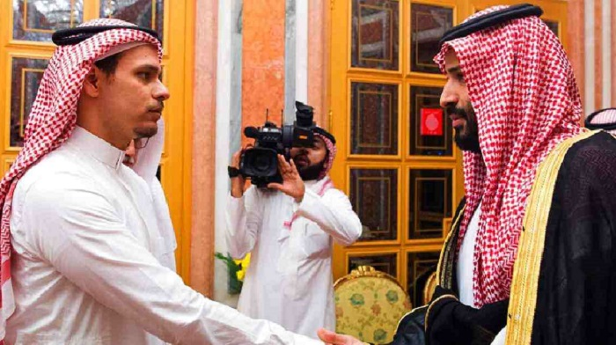
Forgiveness

Slide 2
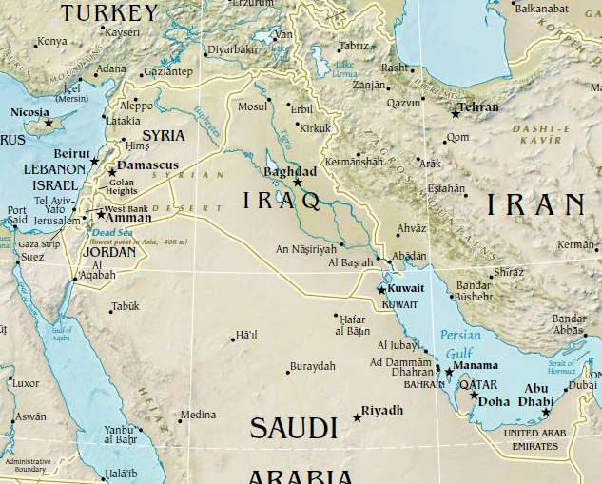

Slide 3
Ezekiel 16
1. We are unlovely, and God is sovereign (1-14)

Slide 4
Ezekiel 16
1. We are unlovely, and God is sovereign (1-14)
2. The natural heart of man is to sin willfully (15-34)

Slide 5
Ezekiel 16
1. We are unlovely, and God is sovereign (1-14)
2. The natural heart of man is to sin willfully (15-34)
3. God is just in his anger and jealousy (35-52)

Slide 6
Ezekiel 16
1. We are unlovely, and God is sovereign (1-14)
2. The natural heart of man is to sin willfully (15-34)
3. God is just in His anger and jealousy (35-52)
4. God’s grace and our right response (59-63)

Slide 7
1 John 4:9-11
In this the love of God was made manifest
among us, that God sent his only Son into the world ,
so that we might live through him. In this is love, not that we
have loved God, but that He loved us and sent His Son to be
the propitiation for our sins. Beloved, if God so loved us,
we also ought to love one another.

Slide 8
The Heart of the Gospel
Forgiveness:
The example of Brandt Jean

