Slide 1
Set Free
a study of Galatians

Slide 2
This is God’s Holy Word. Written by men, inspired by God. God gave it to us that we may understand all things pertaining to life and godliness. These Scriptures are not what save me, but it is the One to whom they testify; that is, Jesus Christ. The Word of God is my authority in life. It is to shape my thinking and transform my life. I will learn it, live it and give it to those around me. Amen

Slide 3
¹³ For you were called to freedom, brothers. Only do not use your freedom as an opportunity for the flesh, but through love serve one another. ¹⁴ For the whole law is fulfilled in one word: “You shall love your neighbor as yourself.” ¹⁵ But if you bite and devour one another, watch out that you are not consumed by one another.
Galatians 5:13-15

Slide 4
What is “Freedom”?
Oxford Languages – “the power or right to act, speak, or think as one wants without hindrance or restraint”
(this is not freedom – this is chaos because of sin)
Freedom = opportunity, ability and responsibility to honor God and others, not yourself.

Slide 5
¹² “So whatever you wish that others would do to you, do also to them, for this is the Law and the Prophets.
Matthew 7:12 (ESV)

Slide 6
¹² “So whatever you wish that others would do to you, do also to them, for this is the Law and the Prophets.
Matthew 7:12 (ESV)
Am I treating them the way I would want to be treated?

Slide 7
¹² “So whatever you wish that others would do to you, do also to them, for this is the Law and the Prophets.
¹³ “Enter by the narrow gate. For the gate is wide and the way is easy that leads to destruction, and those who enter by it are many. ¹⁴ For the gate is narrow and the way is hard that leads to life, and those who find it are few.
Matthew 7:12-14 (ESV)

Slide 8
¹² “So whatever you wish that others would do to you, do also to them, for this is the Law and the Prophets.
¹³ “Enter by the narrow gate. For the gate is wide and the way is easy that leads to destruction, and those who enter by it are many. ¹⁴ For the gate is narrow and the way is hard that leads to life, and those who find it are few.
Matthew 7:12-14 (ESV)
And then will I declare to them, ‘I never knew you; depart from me, you workers of lawlessness.’
Matthew 7:23 (ESV)

Slide 9
Realms of Our Enemy
You
Holy Spirit
Flesh
Satan
World

Slide 10
Realms of Our Enemy
You
Holy Spirit
Flesh
Satan
World

Slide 11
¹⁶ But I say, walk by the Spirit, and you will not gratify the desires of the flesh.
Galatians 5:16

Slide 12
¹⁶ But I say, walk by the Spirit, and you will not gratify the desires of the flesh. ¹⁷ For the desires of the flesh are against the Spirit, and the desires of the Spirit are against the flesh, for these are opposed to each other, to keep you from doing the things you want to do.
Galatians 5:16-17 (ESV)

Slide 13
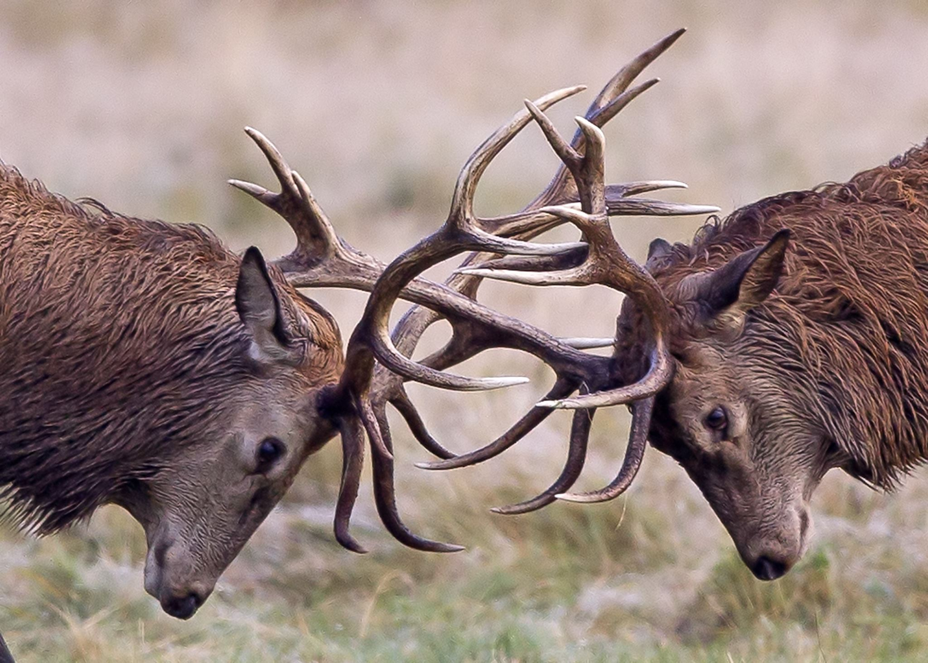
Desires of the
SPIRIT
For the desires of the flesh are against the Spirit, and the desires of the Spirit are against the flesh, for these are opposed to each other, to keep you from doing the things you want to do.
Galatians 5:17
Desires of the
FLESH

Slide 14
¹⁵ I do not understand my own actions. For I do not do what I want, but I do the very thing I hate. ¹⁶ Now if I do what I do not want, I agree with the law, that it is good. ¹⁷ So now it is no longer I who do it, but sin that dwells within me. ¹⁸ For I know that nothing good dwells in me, that is, in my flesh. For I have the desire to do what is right, but not the ability to carry it out. ¹⁹ For I do not do the good I want, but the evil I do not want is what I keep on doing. ²⁰ Now if I do what I do not want, it is no longer I who do it, but sin that dwells within me. ²¹ So I find it to be a law that when I want to do right, evil lies close at hand.
Romans 7:15–21 (ESV)

Slide 15
¹⁸ But if you are led by the Spirit, you are not under the law.
Galatians 5:18 (ESV)

Slide 16
¹⁸ But if you are led by the Spirit, you are not under the law.
¹⁹ Now the works of the flesh are evident: sexual immorality, impurity, sensuality, ²⁰ idolatry, sorcery, enmity, strife, jealousy, fits of anger, rivalries, dissensions, divisions, ²¹ envy, drunkenness, orgies, and things like these. I warn you, as I warned you before, that those who do such things will not inherit the kingdom of God.
Galatians 5:18-21 (ESV)

Slide 17
⁹ No one born of God makes a practice of sinning, for God’s seed abides in him; and he cannot keep on sinning, because he has been born of God.
1 John 3:9 (ESV)

Slide 18
²² But the fruit of the Spirit is love, joy, peace, patience, kindness, goodness, faithfulness, ²³ gentleness, self-control; against such things there is no law. ²⁴ And those who belong to Christ Jesus have crucified the flesh with its passions and desires. ²⁵ If we live by the Spirit, let us also keep in step with the Spirit. ²⁶ Let us not become conceited, provoking one another, envying one another.
Galatians 5:22-26 (ESV)

Slide 19
Signs that you live by the Spirit:
You’re a little fruity

Slide 20
Signs that you live by the Spirit:
You’re a little fruity
You live like Jesus

Slide 21
Signs that you live by the Spirit:
You’re a little fruity
You live like Jesus
You’re led by God’s truth

Slide 22
How to keep in step with the Spirit…
Read, memorize, meditate on the Scriptures
Pray without ceasing
Fast – the absence of one thing stirs us toward another
Serve others
Christ-centered friendships

