Slide 1
Set Free
a study of Galatians

Slide 2
This is God’s Holy Word. Written by men, inspired by God. God gave it to us that we may understand all things pertaining to life and godliness. These Scriptures are not what save me but it is the One to whom they testify; that is, Jesus Christ. The Word of God is my authority in life. It is to shape my thinking and transform my life. I will learn it, live it and give it to those around me. Amen

Slide 3
¹¹ But when Cephas came to Antioch, I opposed him to his face, because he stood condemned.
Galatians 2:11 (ESV)

Slide 4
¹¹ But when Cephas came to Antioch, I opposed him to his face, because he stood condemned. ¹² For before certain men came from James, he was eating with the Gentiles;
Galatians 2:11-12 (ESV)

Slide 5
¹¹ But when Cephas came to Antioch, I opposed him to his face, because he stood condemned. ¹² For before certain men came from James, he was eating with the Gentiles; but when they came he drew back and separated himself, fearing the circumcision party.
Galatians 2:11-12 (ESV)

Slide 6
Jesus comes along – He doesn’t change everything
HE FULFILLS EVERYTHING!

Slide 7
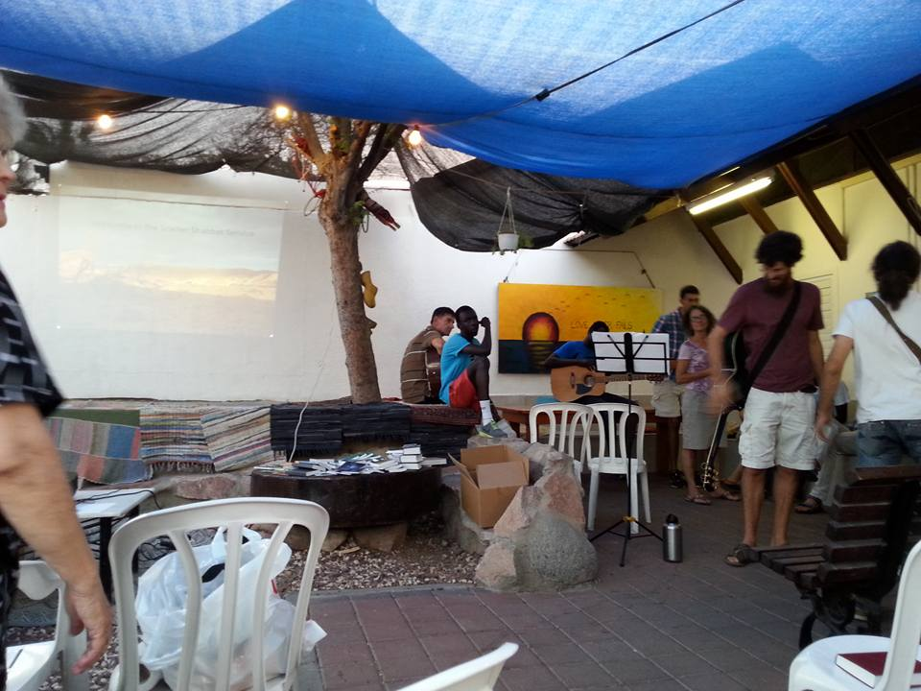
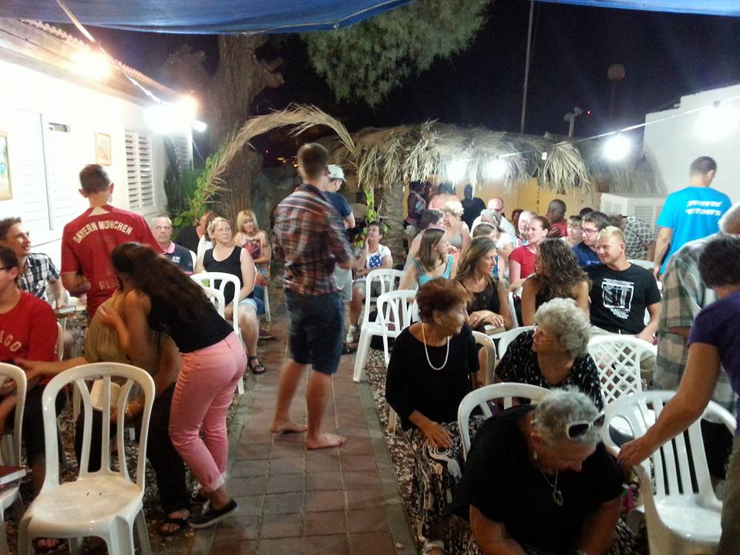
Argentina, Russia, Germany, Finland, Sudan, North America, others…

Slide 8
¹¹ But when Cephas came to Antioch, I opposed him to his face, because he stood condemned. ¹² For before certain men came from James, he was eating with the Gentiles; but when they came he drew back and separated himself, fearing the circumcision party. ¹³ And the rest of the Jews acted hypocritically along with him, so that even Barnabas was led astray by their hypocrisy.
Galatians 2:11-13 (ESV)

Slide 9
¹⁴ But when I saw that their conduct was not in step with the truth of the gospel, I said to Cephas before them all, “If you, though a Jew, live like a Gentile and not like a Jew, how can you force the Gentiles to live like Jews?”
Galatians 2:14 (ESV)

Slide 10
Galatians 6:1 (ESV) - ¹ Brothers, if anyone is caught in any transgression, you who are spiritual should restore him in a spirit of gentleness. Keep watch on yourself, lest you too be tempted.
Matthew 18:15 (ESV) - ¹⁵ “If your brother sins against you, go and tell him his fault, between you and him alone. If he listens to you, you have gained your brother.

Slide 11
Addressing sin with a brother or sister in Christ…
Contend for the gospel – don’t let the presence of sin spoil the appeal of the gospel

Slide 12
Addressing sin with a brother or sister in Christ…
Contend for the gospel – don’t let the presence of sin spoil the appeal of the gospel
Be gracious and gentle in spirit

Slide 13
Addressing sin with a brother or sister in Christ…
Contend for the gospel – don’t let the presence of sin spoil the appeal of the gospel
Be gracious and gentle in spirit
Commit to truth (not preference) – Know the Word

