Slide 3
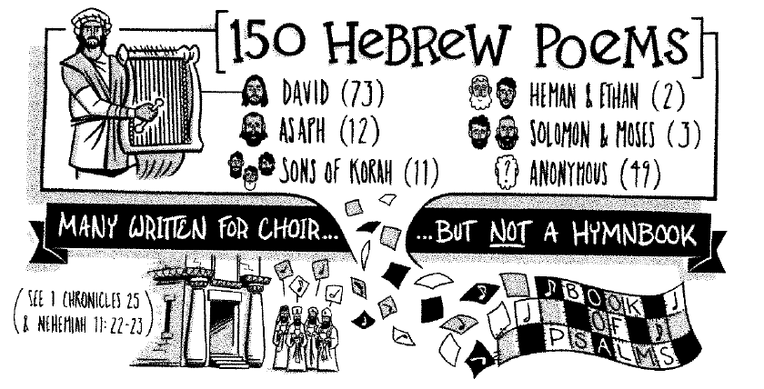

Slide 4
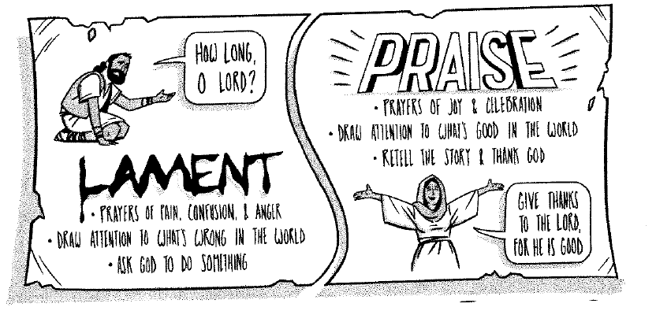

Slide 5
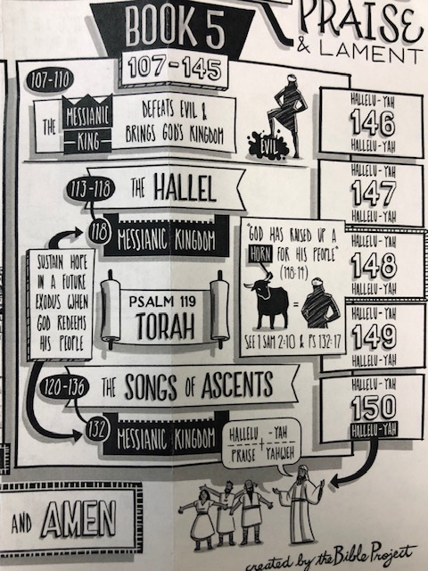

Slide 6
David’s Call to the COVID-19 Generation Key Observations on Psalm 145
Note its placement in the book of Psalms-
Note its superscription – “A Song of Praise. Of David.”
Note its memorable design – Alphabetic acrostic psalm – a,b,c… in the Hebrew language
Note its interactive structure – “I will…they shall…the LORD is…” – 2-line introduction; four paragraphs with key themes about God and a 1-line conclusion.

Slide 7
David’s Call to the COVID-19 Generation Three Questions to Answer from Psalm 145
What does this psalm teach me about God?
What does this psalm teach me about myself/others?
What does this psalm call me/others to do/respond?

Slide 8
David’s Personal Call to Praise – vv. 1-2
I will extol you, my God and King,
and bless your name forever and ever.
² Every day I will bless you
and praise your name forever and ever.
David declares the first reason for praising God…

Slide 9
³ Great is the LORD, and greatly to be praised,
and his greatness is unsearchable.
⁴ One generation shall commend your works to another,
and shall declare your mighty acts.
⁵ On the glorious splendor of your majesty,
and on your wondrous works, I will meditate.
⁶ They shall speak of the might of your awesome deeds,
and I will declare your greatness…
¹³ Your kingdom is an everlasting kingdom, and your
dominion endures throughout all generations.

Slide 10
The Sovereignty of God
“God’s sovereignty is the attribute by which He rules His entire creation as the all-knowing, all-powerful; absolutely free; great and majestic God that He is.”
- A.W. Tozer, The Knowledge of the Holy

Slide 11
The Goodness of God – vv. 7-13
⁷ They shall pour forth the fame of your abundant goodness
and shall sing aloud of your righteousness.
⁸ The LORD is gracious and merciful,
slow to anger and abounding in steadfast love.
⁹ The LORD is good to all,
and his mercy is over all that he has made.

Slide 12
[¹⁰ All your works shall give thanks to you, O LORD,
and all your saints shall bless you!
¹¹ They shall speak of the glory of your kingdom
and tell of your power,
¹² to make known to the children of man your mighty deeds,
and the glorious splendor of your kingdom.
^{13a} Your kingdom is an everlasting kingdom,
and your dominion endures throughout all generations.

Slide 13
The Goodness of God
“The goodness of God is that which disposes Him to be kind, cordial, benevolent, and full of good will toward men and women. He is tenderhearted and of quick sympathy, and His unfailing attitude toward all moral beings is open, frank, and friendly. By His nature He is inclined to bestow blessedness and He takes total pleasure in the happiness of His people.”
- A.W. Tozer, The Knowledge of the Holy

Slide 14
The Faithful Care of God – vv. 13b-20
^{13b} The LORD is faithful in all his words
and kind in all his works.
¹⁴ The LORD upholds all who are falling
and raises up all who are bowed down.
¹⁵ The eyes of all look to you,
and you give them their food in due season.
¹⁶ You open your hand;
you satisfy the desire of every living thing.

Slide 15
¹⁷ The LORD is righteous in all his ways
and kind in all his works.
¹⁸ The LORD is near to all who call on him,
to all who call on him in truth.
¹⁹ He fulfills the desire of those who fear him;
he also hears their cry and saves them.
²⁰ The LORD preserves all who love him,
but all the wicked he will destroy.

Slide 16
The Faithfulness & Care of God
“God is dependable, trustworthy, loyal, resolute, constant, reliable and true to His word—always and forever… He keeps his promises and is consistent with his character as He cares for creation & His people.”
- Chip Ingram, The Real God

Slide 17
David’s Invitation for Us to Praise God – v. 21
²¹ My mouth will speak the praise of the LORD,
and let all flesh bless his holy name
forever and ever.

Slide 18
David’s Assignments for Us Today
Make praise to God a daily practice all the days of your life.
“Every day I will bless you and praise your name forever and ever.”

Slide 19
David’s Assignments for Us Today
Make praise to God a daily practice all the days of your life.
Make sure to tell your family members of the ways you have seen God at work in your life.
“One generation shall commend your works to another,
and shall declare your mighty acts.” (v. 4)

Slide 20
David’s Assignments for Us Today
Make praise to God a daily practice all the days of your life.
Make sure to tell your family members of the ways you have seen God at work in your life.
Rest in the character of God through all of life’s situations – and keep praising Him for who He is and all He has done in your life—and encourage others to do likewise!

Slide 21
Praise the Lord by The Imperials (1979)
When you’re up against the struggle that shatters all your dreams
And you hopes have been cruelly crushed by Satan’s manifested schemes
And you feel the urge within you to submit to earthly fears
Don’t let the faith you’re standing in seem to disappear.
Praise the Lord! He can work through those who praise Him
Praise the Lord! For our God inhabits praise
Praise the Lord! For the chains that seem to bind you serve only to remind you that they drop powerless behind you when you praise Him.

