Slide 1
How an Obscure Bible Story Can Change Your Life Today
Dr. Wayne A Vanderwier
Director-at-Large
Overseas Instruction in Counseling
October 18, 2020

Slide 2
Thank you Crossroads Church!

Slide 3
“No one would voluntarily preach on this.
You have to be basically forced into it.”
Pastor John MacArthur
I volunteered!

Slide 4
Galatians 4:21-5:1

Slide 5
Let’s Pray!

Slide 6
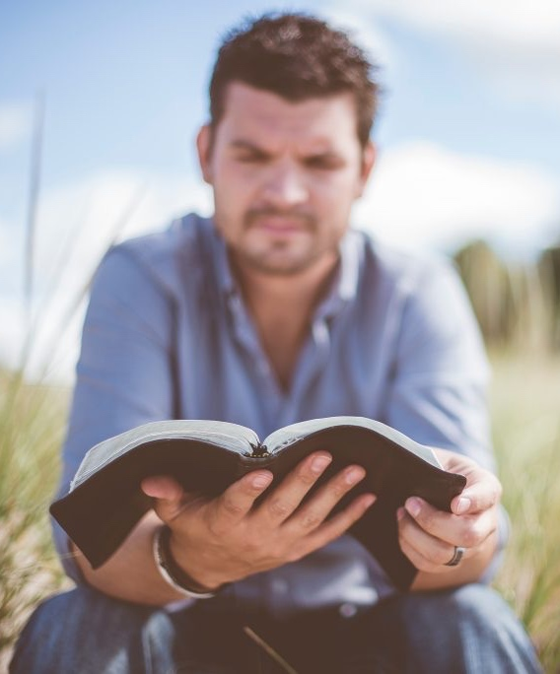
Chapters 1 & 2 – A personal defense of the true gospel.
The Structure of Galatians
Chapter 3 & 4 – A Biblical / theological defense of the true gospel.
Chapters 5 & 6 – The practical implications of the true gospel.

Slide 7
This story challenges you to trust God’s plan for your life. Galatians 4:21-23

Slide 8
After these things the word of the LORD came to Abram in a vision: “Fear not, Abram, I am your shield; your reward shall be very great.” But Abram said, “O Lord GOD, what will You give me, for I continue childless, and the heir of my house is Eliezer of Damascus?” And Abram said, “Behold, You have given me no offspring, and a member of my household will be my heir.”
Genesis 15:1-6

Slide 9
And behold, the word of the LORD came to him: “This man shall not be your heir; your very own son shall be your heir.” And he brought him outside and said, “Look toward heaven, and number the stars, if you are able to number them.” Then he said to him, “So shall your offspring be.” And he believed the LORD, and he counted it to him as righteousness.
Genesis 15:1-6

Slide 10
Now Sarai, Abram's wife, had borne him no children. She had a female Egyptian servant whose name was Hagar. And Sarai said to Abram, “Behold now, the LORD has prevented me from bearing children. Go in to my servant; it may be that I shall obtain children by her.” And Abram listened to the voice of Sarai.
Genesis 16:1-4a

Slide 11
So, after Abram had lived ten years in the land of Canaan, Sarai, Abram's wife, took Hagar the Egyptian, her servant, and gave her to Abram her husband as a wife. And he went in to Hagar, and she conceived.
Genesis 16:1-4a

Slide 12
And God said to Abraham, “As for Sarai your wife, you shall not call her name Sarai, but Sarah shall be her name. I will bless her, and moreover, I will give you a son by her. I will bless her, and she shall become nations; kings of peoples shall come from her.” Then Abraham fell on his face and laughed and said to himself, “Shall a child be born to a man who is a hundred years old? Shall Sarah, who is ninety years old, bear a child?”
Genesis 17:15-17

Slide 13
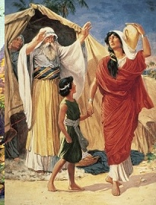
Ishmael pictures all those who try to please God and accomplish God’s will by the flesh. It’s sinful, it’s useless, it creates bondage.

Slide 14
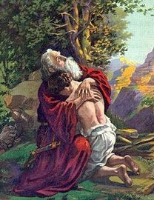
Isaac symbolizes all those who do the will of God by faith in His promise. He does the work; He brings it to pass; He receives the glory.

Slide 15
“How to Be Set Free from Voluntary Slavery to Destructive Affections”
In our training …
re: “Addictions”

Slide 16
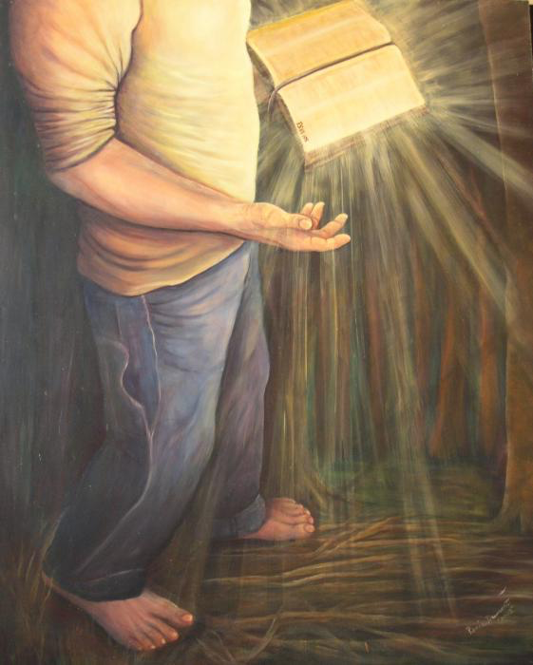
Trust in the LORD with all your heart, (illustrated by Isaac) and do not lean on your own understanding. (illustrated by Ishmael) In all your ways acknowledge Him, and He will make straight your paths.
Proverbs 3:5-6

Slide 17
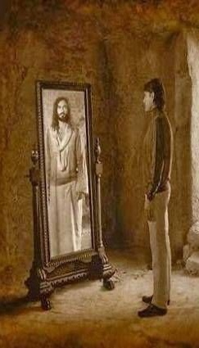
This story clarifies the issue of your identity. Galations 4:24-27

Slide 18
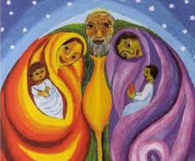
Abraham had two sons: Ishmael and Isaac.
They were born of two mothers: Hagar and Sarah.
They represent two covenants: Old and New.

Slide 19
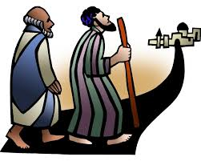
Present (earthly) Jerusalem and Future (heavenly) Jerusalem.
They are symbolized in two Jerusalems:

Slide 20
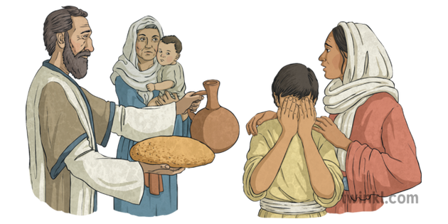
Hagar is law and bondage and death. Sarah is grace and faith and freedom.

Slide 21
If you’re a believer in Jesus Christ that’s your identity.

Slide 22
Isaiah 54:4-5
“Fear not, for you will not be ashamed; Be not confounded, for you will not be disgraced;
For you will forget the shame of your youth,
And the reproach of your widowhood
You will remember no more.
For your Maker is your husband, The LORD of hosts is His name;
And the Holy One of Israel is your Redeemer, The God of the whole earth He is called.

Slide 23
if you’re a believer in Jesus Christ that’s your identity.
Again,

Slide 24
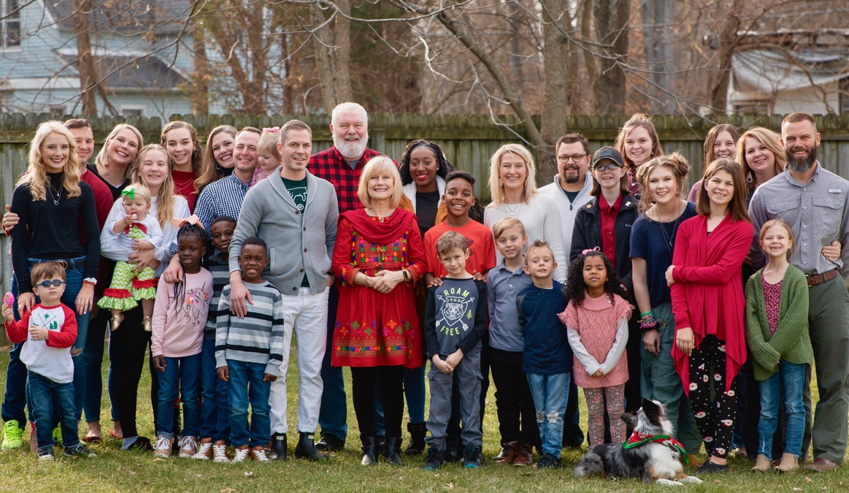

Slide 25
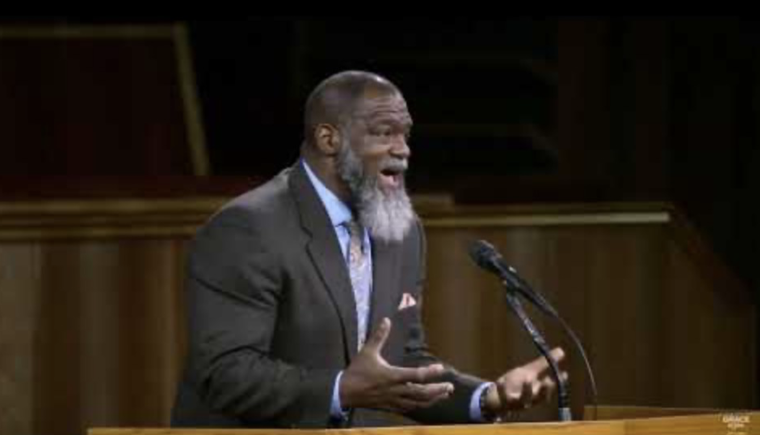

Slide 26
Jesus loves the little children, All the children of the world. Red and yellow, black and white, They are precious in His sight. Jesus loves the little children of the world.

Slide 27
Jesus loves the little children, All the children of the world. They are precious in His sight. Jesus loves the little children of the world.
Shades of brown from dark to light,

Slide 28
Identity Options:
You are either lost – a slave to sin;
Under the curse of the law;
Figurative Ishmael, slave son of slave Hagar;
Trapped in soul-crushing legalism now;
Rushing toward eternal judgement.
OR

Slide 29
Identity Options:
You are redeemed – living in righteousness;
Released from the tyranny of the law;
Figurative Isaac, free son of free Sarah;
Enjoying the soul-satisfying delight of freedom now;
Moving toward eternal joy in the presence of your Redeemer and Lord, Jesus.

Slide 30
This story liberates you to walk in the freedom you have in Christ. Galations 4:28-5:1

Slide 31
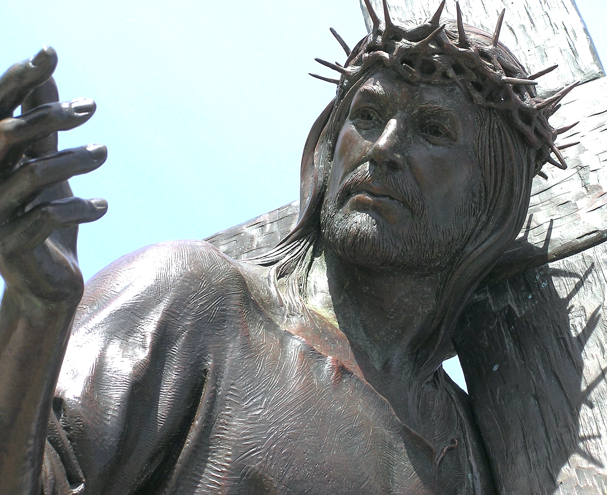
“Now you, brothers, like Isaac, are children of promise.” You have been born again by a miracle of sovereign grace.
Galatians 4:28

Slide 32
You did not invent the idea of salvation, you did not do anything to get your salvation, and you cannot do anything to keep your salvation.

Slide 33
This story exhorts you to remain firm in the freedom you have in Christ. Galations 5:1

Slide 34
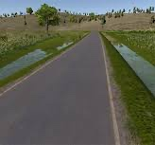
One Side: Submitting again to the yoke of bondage.
As is often the case,
there is a ditch on both sides of the road:
The Other Side:
Living without limits;
lasciviousness, license, antinomianism.

Slide 35
An obscure OT story?
Yes. But this story …
Challenges you to trust God’s plan for your life.
Clarifies the issue of your identity.
Liberates you to walk in the freedom you have in Christ.
Exhorts you to remain firm in the freedom you have in Christ.

Slide 36
What will you do?

Slide 37
Sanctify them in the truth; Your Word is truth. John17:17

