Slide 1
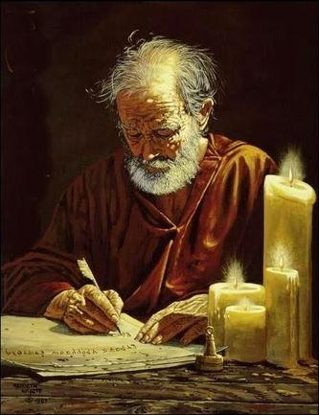
“THE POWER OF THE GOSPEL”
Galatians 1:11-24

Slide 2
11
For I would have you know, brothers, that the gospel that was preached by me is not man's gospel.

Slide 3
12
For I did not receive it from any man, nor was I taught it, but I received it through a revelation of Jesus Christ.

Slide 4
13
For you have heard of my former life in Judaism, how I persecuted the church of God violently and tried to destroy it.

Slide 5
14
And I was advancing in Judaism beyond many of my own age among my people, so extremely zealous was I for the traditions of my fathers.

Slide 6
15
But when he who had set me apart before I was born, and who called me by his grace,

Slide 7
was pleased to reveal his Son to me, in order that I might preach him among the Gentiles, I did not immediately consult with anyone;
16

Slide 8
17
nor did I go up to Jerusalem to those who were apostles before me, but I went away into Arabia, and returned again to Damascus.

Slide 9
18
Then after three years I went up to Jerusalem to visit Cephas and remained with him fifteen days.

Slide 10
19
But I saw none of the other apostles except James the Lord's brother.

Slide 11
In what I am writing to you, before God, I do not lie!
20

Slide 12
21
Then I went into the regions of Syria and Cilicia.

Slide 13
22
And I was still unknown in person to the churches of Judea that are in Christ.

Slide 14
23
They only were hearing it said, “He who used to persecute us is now preaching the faith he once tried to destroy.”

Slide 15
24
And they glorified God because of me.

