Slide 1
A Fruitful Life
Part 2

Slide 2
This is God’s Holy Word. Written by men, inspired by God. God gave it to us that we may understand all things pertaining to life and godliness. These Scriptures are not what save me, but it is the One to whom they testify; that is, Jesus Christ. The Word of God is my authority in life. It is to shape my thinking and transform my life. I will learn it, live it and give it to those around me. Amen

Slide 3
Galatians 5
22 But the fruit of the Spirit is love, joy, peace, patience, kindness, goodness, faithfulness, 23 gentleness, self-control; against such things there is no law.

Slide 4
Recap:
Fruit of Spirit are contrasting and in opposition to works of the flesh.
Fruit of the Spirit is produced by the Holy Spirit...not us.
Our role is to nurture the environment.

Slide 5
Patience= Waiting With Grace
Unpleasant Waiting
Enduring
Longsuffering
Forbearance

Slide 6
Fruit of the Spirit are not produced by us…
and are not produced on our timeline.

Slide 7
“Waiting for God is at the heart of living by faith.”
- RC Sproul

Slide 8
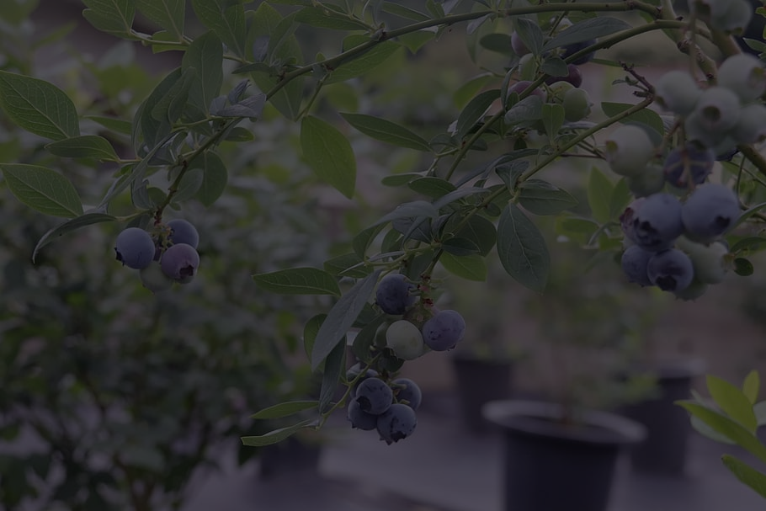
I will eagerly wait with anticipation and hope.

Slide 9
We wait...but we don’t wait alone!

Slide 10
Kindness
Thoughtful of others; not seeking personal gain
Sincere/Respectful
Heart posture of gratitude
Tender concern and useful to others (“Lovingly Practical”)

Slide 11
My thoughts and words reflect my true heart.

Slide 12
Goodness
Characterized by deeds
Benefiting others
Participating with God

Slide 13
I am a participant with God and am called to enhance something.

Slide 14
Galatians 5
22 But the fruit of the Spirit is love, joy, peace, patience, kindness, goodness, faithfulness, 23 gentleness, self-control; against such things there is no law.

Slide 15
Encountering Fruit of the Spirit leads to Repentance

