Slide 1
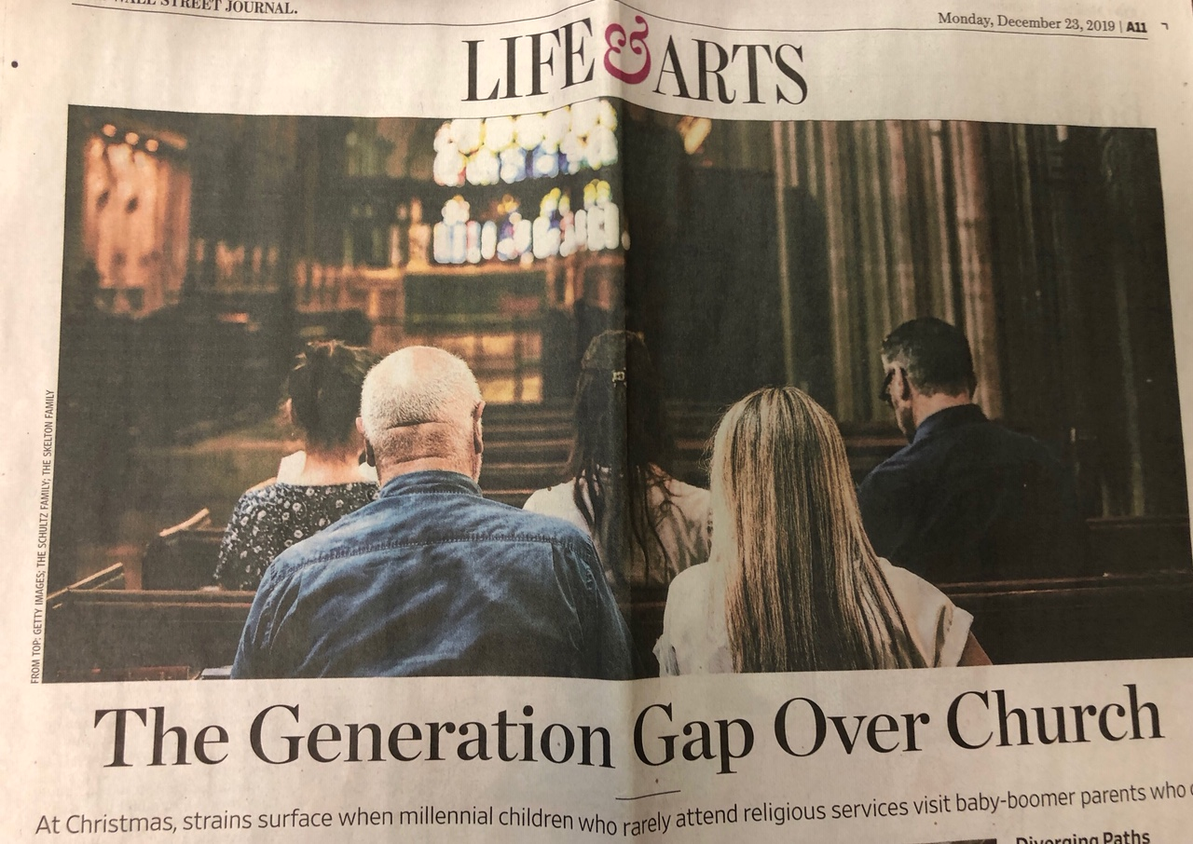

Slide 3
¹ Again I saw all the oppressions that are done under the sun. are already dead more fortunate than the living who are still alive. ³ But better than both is he who has not yet been and has not seen the evil deeds that are done under the sun.

Slide 4
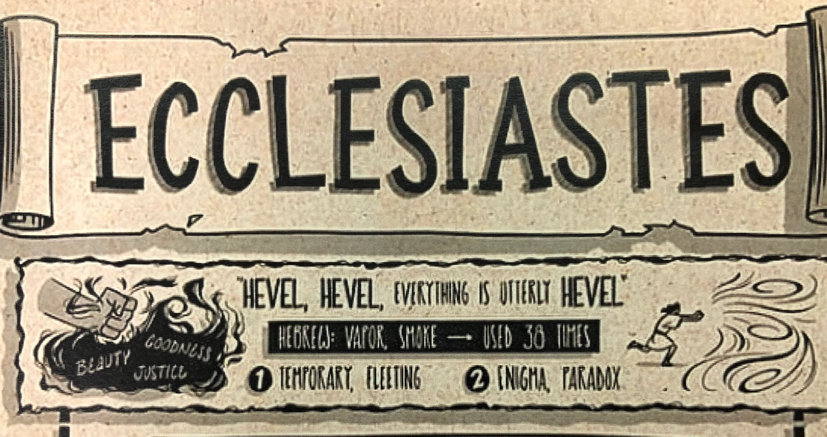
¹ Again I saw all the oppressions that are done under the sun. are already dead more fortunate than the living who are still alive. ³ But better than both is he who has not yet been and has not seen the evil deeds that are done under the sun.

Slide 5
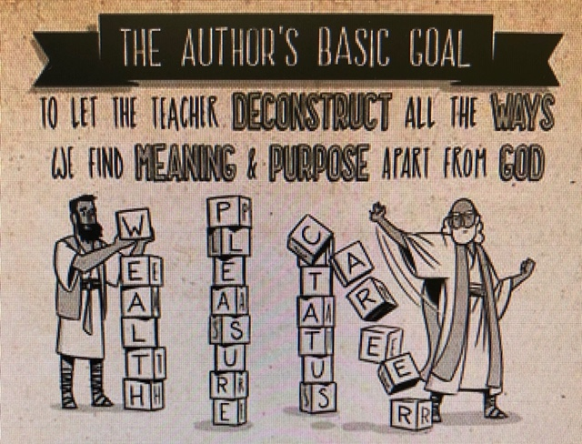

Slide 6
Apart from God = ‘Under the Sun’ = Secularism
Defined: Life without reference to God; trying to solve life’s
riddles by our own mind, unaided by God
“The question of God is simply irrelevant to so much of what
we do on a daily basis that it eventually drops out of mind
and heart…God is simply forgotten.”
- Craig M. Gay, The Way of the (Modern) World

Slide 7
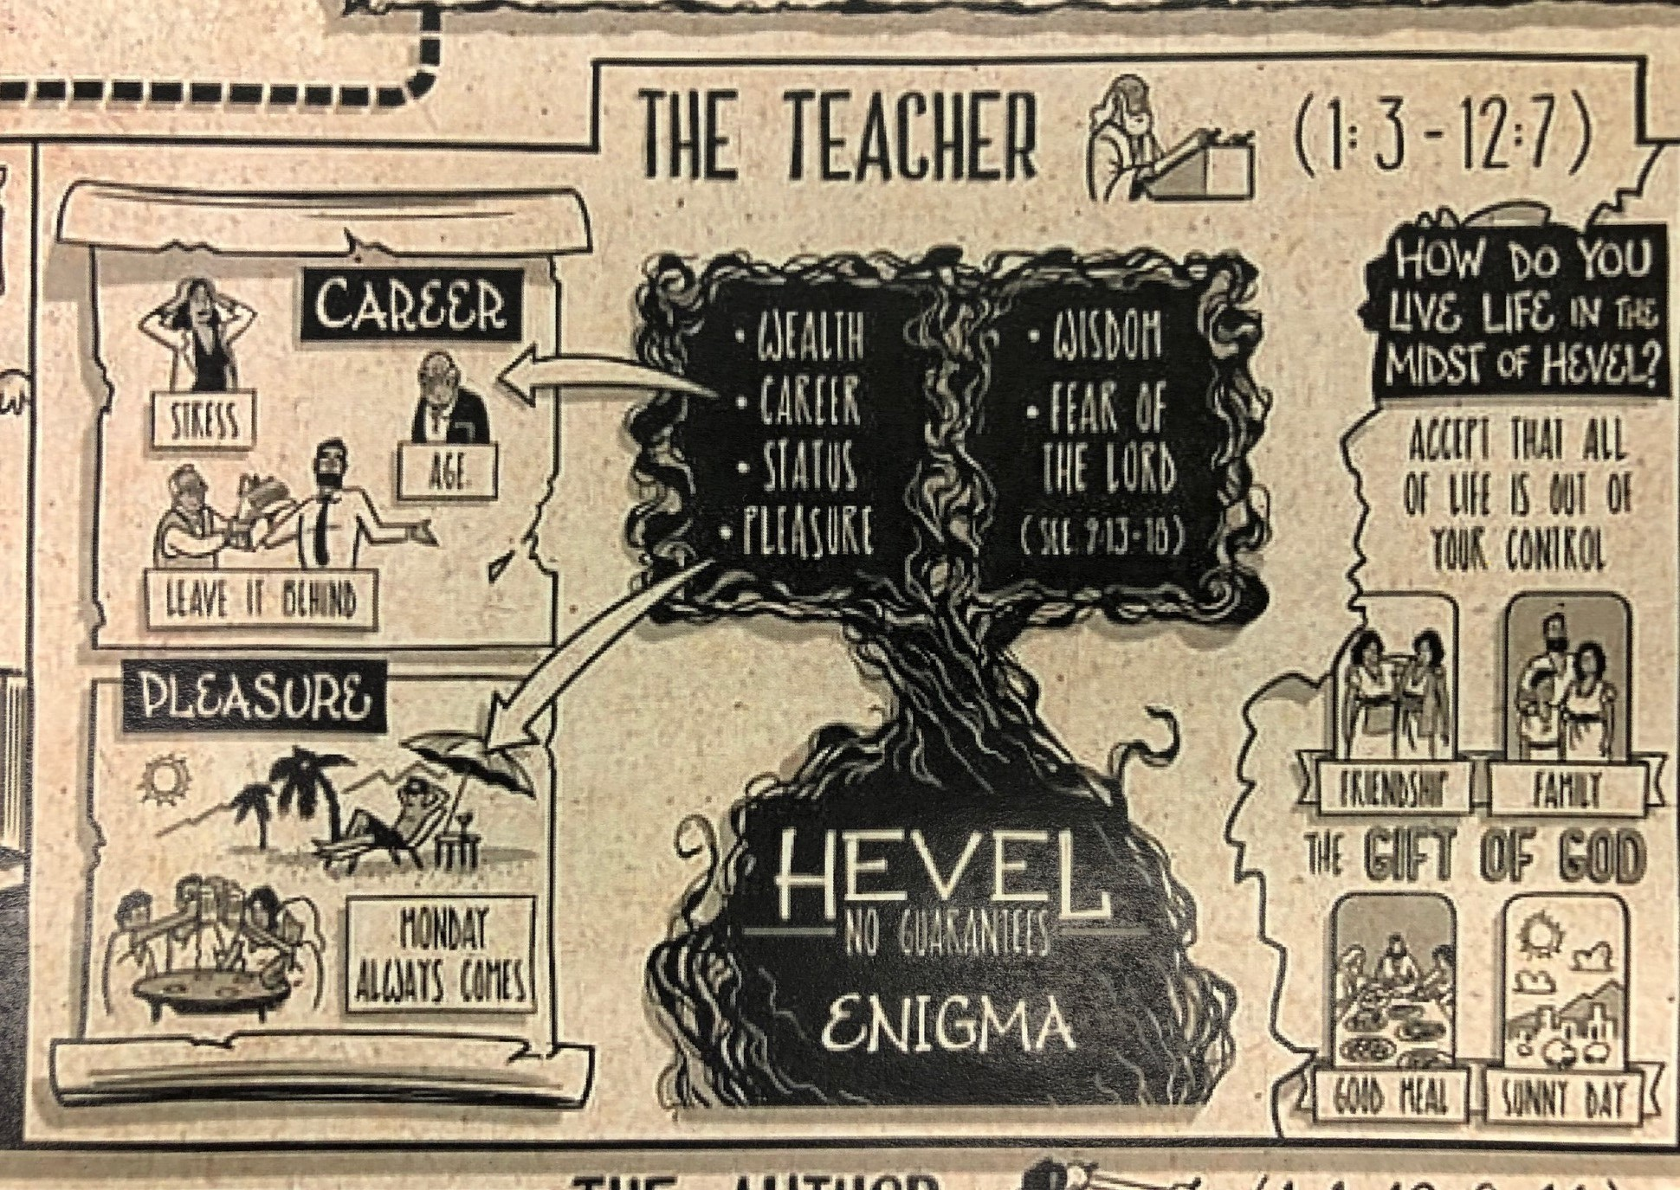

Slide 8
¹ Guard your steps when you go to the house of God. To draw near to listen is better than to offer the sacrifice of fools, for they do not know that they are doing evil. ² Be not rash with your mouth, nor let your heart be hasty to utter a word before God, for God is in heaven and you are on earth. Therefore let your words be few. ³ For a dream comes with much business, and a fool's voice with many words. - Ecclesiastes 5:1–3 (ESV)

Slide 9
⁴ When you vow a vow to God, do not delay paying it, for he has no pleasure in fools. Pay what you vow. ⁵ It is better that you should not vow than that you should vow and not pay. ⁶ Let not your mouth lead you into sin, and do not say before the messenger that it was a mistake. Why should God be angry at your voice and destroy the work of your hands? ⁷ For when dreams increase and words grow many, there is vanity; but God is the one you must fear. - Ecclesiastes 5:4-7 (ESV)

Slide 10
I. The Dangers of a Nominal Faith (Eccles. 5:1-7)
The Opening Warning (v. 1)
Guard your steps when you go to the house of God…
Lit. give careful thought to, consider your purpose for going

Slide 11
I. The Dangers of a Nominal Faith (Eccles. 5:1-7)
The Opening Warning (v. 1)
Guard your steps when you go to the house of God…
“The Preacher is warning his readers against thoughtlessly running to the place of worship without first considering the nature of the place and your purpose for going.” – George Barton
“Search me, O God, and know my heart! Try me and know my
thoughts…” (Psalm 139:23 ESV)

Slide 12
I. The Dangers of a Nominal Faith (Eccles. 5:1-7)
The Opening Warning (v. 1)
The Symptoms of Nominal Worship ( vv. 2-7a)

Slide 13
I. The Dangers of a Nominal Faith (Eccles. 5:1-7)
The Opening Warning (v. 1)
The Symptoms of Nominal Worship ( vv. 2-7a)
Too many words – Not much listening
As you enter the house of God, keep your ears open and your mouth shut. It is evil to make mindless offerings to God. (v. 1 NLT)
“Speak, Lord, for your servant is listening…” (1 Samuel 3:10)

Slide 14
I. The Dangers of a Nominal Faith (Eccles. 5:1-7)
The Opening Warning (v. 1)
The Symptoms of Nominal Worship ( vv. 2-7a)
Too many words – Not much listening
Lack of heartfelt reverence for God – Object of our worship
Don’t be hasty in bringing matters before God. After all, God is in heaven, and you are here on earth. So let your words be few. (v. 2b)

Slide 15
A Common Spiritual Problem
And the Lord said: ‘Because this people draw near with their mouth and honor me with their lips, while their hearts are far from me…”
- Isaiah 29:13
And they come to you as people come, and they sit before you as my people, and they hear what you say but they do not do it…their heart is set on their gain.” - Ezekiel 33:31
Well did Isaiah prophesy of you, when he said: ‘This people honors me with their lips, but their heart is far from me…’ – Matt. 15:8

Slide 16
Pray then like this: Our Father in heaven, hallowed be your name…
- Matthew 6:9 ESV
But you have come to Mount Zion and to the city of the living God, the heavenly Jerusalem, and to innumerable angels in festal gathering, and to the assembly of the firstborn who are enrolled in heaven, and to God, the judge of all…Therefore let us be grateful for receiving a kingdom that cannot be shaken, and thus let us offer to God acceptable worship, with reverence and awe, for our God is a consuming fire. - Hebrews 12:22-23, 28-29 (ESV)

Slide 17
I. The Dangers of a Nominal Faith (Ecc. 5:1-7)
The Warning (v. 1)
The Symptoms of Nominal Worship ( vv. 2-7a)
Too many words – Not much listening
Lack of heartfelt reverence for God – Object of our worship
Vows/Promises made carelessly/denied/delayed

Slide 18
⁴ When you make a promise to God, don’t delay in following through, for God takes no pleasure in fools. Keep all the promises you make to him. ⁵ It is better to say nothing than to make a promise and not keep it. ⁶ Don’t let your mouth make you sin. And don’t defend yourself by telling the Temple messenger that the promise you made was a mistake. That would make God angry, and he might wipe out everything you have achieved. ⁷ Talk is cheap, like daydreams and other useless activities. Fear God instead.
- Ecclesiastes 5:4-7 (NLT)

Slide 19
I. The Dangers of a Nominal Faith (Ecc. 5:1-7)
The Opening Warning (v. 1)
The Symptoms of Nominal Worship ( vv. 2-7a)
Too many words – Not much listening
Lack of heartfelt reverence for God – Object of our worship
Vows/Promises made carelessly/denied/delayed
Solution: Heart preparation for worship/reverence (v. 7b)

Slide 20
Another Way to Look at This Passage
“These verses are an important part of Solomon’s argument, warning against the folly of rash vows which could cause a person to lose the fruits of his labor through God’s destroying the work of his hands (v. 6) as making and breaking such vows is sin resulting in God’s displeasure (v. 4) and anger (v. 6).”
- Donald R. Glenn, The Bible Knowledge Commentary

Slide 21
⁴ When you make a promise to God, don’t delay in following through, for God takes no pleasure in fools. Keep all the promises you make to him. ⁵ It is better to say nothing than to make a promise and not keep it. ⁶ Don’t let your mouth make you sin. And don’t defend yourself by telling the Temple messenger that the promise you made was a mistake. That would make God angry, and he might wipe out everything you have achieved. ⁷ Talk is cheap, like daydreams and other useless activities. Fear God instead.
- Ecclesiastes 5:4-7 (NLT)
Do not be deceived; God is not mocked, for whatever one sows, that will he also reap. - Galatians 6:7 (ESV)

Slide 22
Solomon Returns to the Theme of Oppression
Ecclesiastes 5:8-9

Slide 23
⁸ If you see in a province the oppression of the poor and the violation of justice and righteousness, do not be amazed at the matter, for the high official is watched by a higher, and there are yet higher ones over them. ⁹ But this is gain for a land in every way: a king committed to cultivated fields.
Ecclesiastes 5:8-9 (ESV)

Slide 24
What is oppression?
Oppression is when someone uses their power to exploit others to keep or increase their power

Slide 25
⁸ Don’t be surprised if you see a poor person being oppressed by the powerful and if justice is being miscarried throughout the land. For every official is under orders from higher up, and matters of justice get lost in red tape and bureaucracy. ⁹ Even the king milks the land for his own profit!
- Ecclesiastes 5:8-9 (NLT)

Slide 26
Solomon’s observation: The poor can be oppressed both by sinful individuals (Eccles 4:1-4) and by a government/ruler or bureaucracy populated by sinful people. (Eccles 5:8-9)

Slide 27
Solomon’s Further Observations on Wealth & Prosperity
Ecclesiastes 5:10-17

Slide 28
¹⁰ He who loves money will not be satisfied with money, nor he who loves wealth with his income; this also is vanity. ¹¹ When goods increase, they increase who eat them, and what advantage has their owner but to see them with his eyes? ¹² Sweet is the sleep of a laborer, whether he eats little or much, but the full stomach of the rich will not let him sleep.
Ecclesiastes 5:10-12 (ESV)

Slide 29
¹³ There is a grievous evil that I have seen under the sun: riches were kept by their owner to his hurt, ¹⁴ and those riches were lost in a bad venture. And he is father of a son, but he has nothing in his hand. ¹⁵ As he came from his mother's womb he shall go again, naked as he came, and shall take nothing for his toil that he may carry away in his hand. ¹⁶ This also is a grievous evil: just as he came, so shall he go, and what gain is there to him who toils for the wind? ¹⁷ Moreover, all his days he eats in darkness in much vexation and sickness and anger.
Ecclesiastes 5:13-17 (ESV)

Slide 30
Solomon on Wealth & Prosperity
Money/wealth doesn’t satisfy – Hoarding won’t help

Slide 31
Solomon on Wealth & Prosperity
Money/wealth doesn’t satisfy – Hoarding won’t help
More wealth brings additional challenges/problems
More people wanting your wealth
More worries about preserving your wealth
More possibilities of financial reversals/loss

Slide 32
Solomon on Wealth & Prosperity
Money/wealth doesn’t satisfy – Hoarding won’t help
More wealth brings additional challenges/problems
More people wanting your wealth
More worries about preserving your wealth
More possibilities of financial reversals/loss
You can’t take any of your wealth with you at death
Conclusion: So why work so hard to attain wealth if you can’t enjoy it now or take it with you? Remember Jesus’ words in Mt 6:19-21

Slide 33
Solomon Wise Conclusions about Life
Ecclesiastes 5:18-20

Slide 34
¹⁸ Behold, what I have seen to be good and fitting is to eat and drink and find enjoyment in all the toil with which one toils under the sun the few days of his life that God has given him, for this is his lot. ¹⁹ Everyone also to whom God has given wealth and possessions and power to enjoy them, and to accept his lot and rejoice in his toil—this is the gift of God. ²⁰ For he will not much remember the days of his life because God keeps him occupied with joy in his heart. - Ecclesiastes 5:18-20 (ESV)

Slide 35
Solomon Wise Conclusion about Life
Ecclesiastes 5:18-20
View life’s blessings as gifts from God our Creator
2. See our work as God’s calling for our lives—and enjoy it!

Slide 36
¹⁸ Even so, I have noticed one thing, at least, that is good. It is good for people to eat, drink, and enjoy their work under the sun during the short life God has given them, and to accept their lot in life. ¹⁹ And it is a good thing to receive wealth from God and the good health to enjoy it. To enjoy your work and accept your lot in life—this is indeed a gift from God. ²⁰ God keeps such people so busy enjoying life that they take no time to brood over the past.
Ecclesiastes 5:18-20 (NLT)

Slide 37
Solomon Wise Conclusion about Life
Ecclesiastes 5:18-20
View life’s blessings as gifts from God our Creator
See our work as God’s calling for our lives—and enjoy it!
Accept the level of income God has provided for us in life—and moderate the relentless pursuit for ‘more’.

Slide 38
Solomon Wise Conclusion about Life
Ecclesiastes 5:18-20
View life’s blessings as gifts from God our Creator
See our work as God’s calling for our lives—and enjoy it!
Accept the level of income God has provided for us in life—and moderate the relentless pursuit for ‘more’.
For the Gentiles seek after all these things, and your heavenly
Father knows that you need them all. But seek first the kingdom
of God and his righteousness, and all these things shall be added
to you. – Matthew 6:32-33 (ESV)

Slide 39
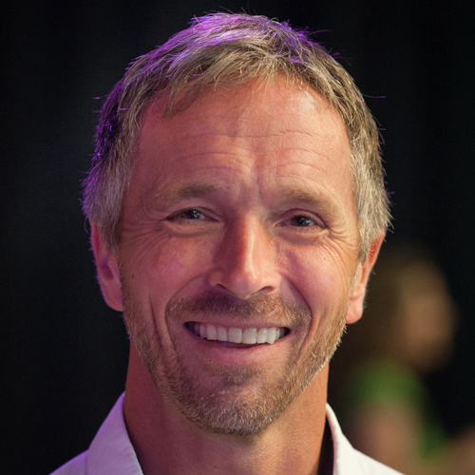
A Timely Resource

Slide 40
Declarations of Freedom – Dr. Jeff Myers – Summit Ministries
I am loved – Deep, unconditional love exists and I can have it in a relationship with my Creator & Savior, Jesus Christ

Slide 41
Declarations of Freedom – Dr. Jeff Myers – Summit Ministries
I am loved – Deep, unconditional love exists and I can have it in a relationship with my Creator & Savior, Jesus Christ
My suffering will be overcome – Hurt will not win. Indeed, it already has lost—at the Cross & Empty Tomb.

Slide 42
Declarations of Freedom – Dr. Jeff Myers – Summit Ministries
I am loved. Deep, unconditional love exists and I can have it in a relationship with my Creator & Savior, Jesus Christ
My suffering will be overcome. Hurt will not win. Indeed, it already has lost—at the Cross & Empty Tomb.
I have an incredible calling. I bear God’s image. My life has meaning. Because I am ‘in Christ’, I have real hope for the future.

Slide 43
Declarations of Freedom – Dr. Jeff Myers – Summit Ministries
I am loved. Deep, unconditional love exists and I can have it in a relationship with my Creator & Savior, Jesus Christ
My suffering will be overcome. Hurt will not win. Indeed, it already has lost—at the Cross & Empty Tomb.
I have an incredible calling. I bear God’s image. My life has meaning. ‘In Christ’, I have real hope for the future.
I am meant for community. I can overcome conflict and live at peace with those around me. I have a forever family.

Slide 44
Declarations of Freedom – Dr. Jeff Myers – Summit Ministries
I am loved. Deep, unconditional love exists and I can have it in a relationship with my Creator & Savior, Jesus Christ
My suffering will be overcome. Hurt will not win. Indeed, it already has lost—at the Cross & Empty Tomb.
I have an incredible calling. I bear God’s image. My life has meaning. ‘In Christ’, I have real hope for the future.
I am meant for community. I can overcome conflict and live at peace with those around me. I have a forever family.
There is hope for the world. I am not doomed. What is right and just and true will win in the end. God will see to it!

