Slide 1
Set Free
a study of Galatians

Slide 2
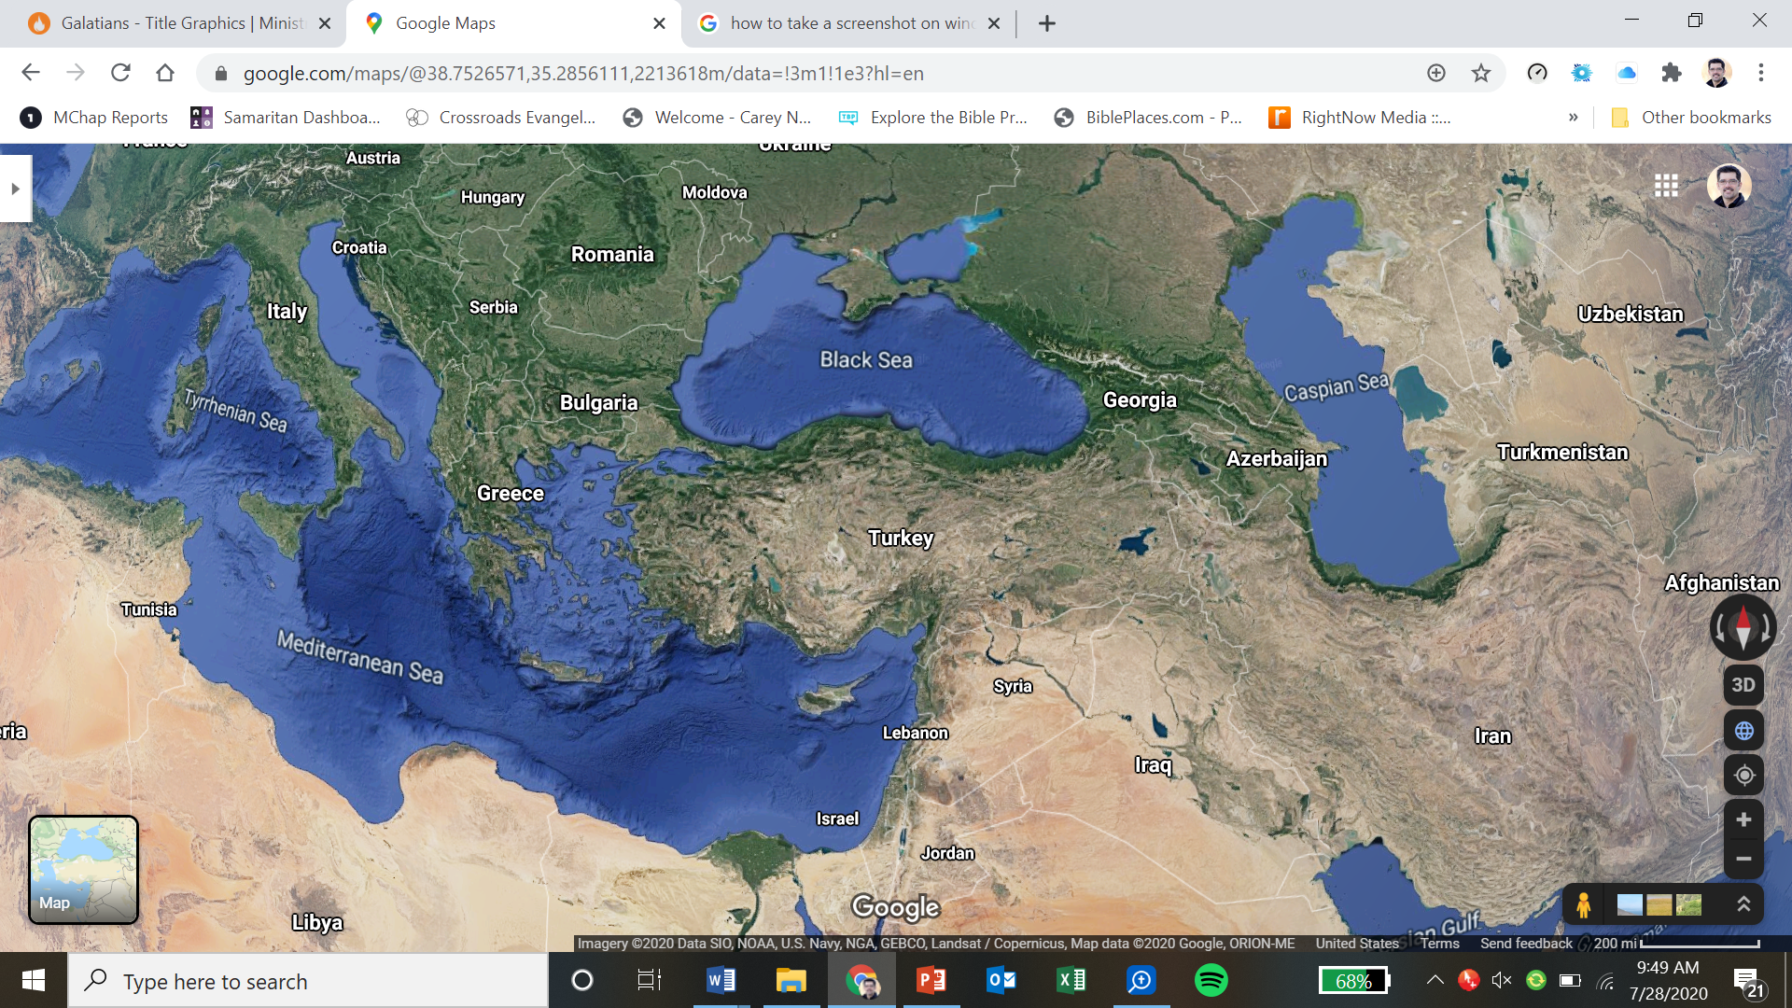
Google Maps

Slide 3
Generally, two responses to salvation by grace alone…
It can’t be – we add requirements (Jesus+)
That means I get to do whatever I want – license to sin

Slide 4
…‘You wicked servant! I forgave you all that debt because you pleaded with me. ³³ And should not you have had mercy on your fellow servant, as I had mercy on you?’ ³⁴ And in anger his master delivered him to the jailers, until he should pay all his debt.
Matthew 18:32–35 (ESV)

Slide 5
…‘You wicked servant! I forgave you all that debt because you pleaded with me. ³³ And should not you have had mercy on your fellow servant, as I had mercy on you?’ ³⁴ And in anger his master delivered him to the jailers, until he should pay all his debt. ³⁵So also my heavenly Father will do to every one of you, if you do not forgive your brother from your heart.”
Matthew 18:32–35 (ESV)

Slide 6
¹ Paul, an apostle—not from men nor through man, but through Jesus Christ and God the Father, who raised him from the dead— ² and all the brothers who are with me, To the churches of Galatia: ³ Grace to you and peace from God our Father and the Lord Jesus Christ, ⁴ who gave himself for our sins to deliver us from the present evil age, according to the will of our God and Father, ⁵ to whom be the glory forever and ever. Amen.
Galatians 1:1–5 (ESV)

Slide 7
Apostle = one sent out with a particular message by the initiation and authority of another

Slide 8
Deliver us from the present evil age…
Delivered from the penalty of your sin while living in a world still subject to the penalty of sin.

Slide 9
Deliver us from the present evil age…
Delivered from the penalty of your sin while living in a world still subject to the penalty of sin.
Delivered from bondage to sin

Slide 10
¹ For freedom Christ has set us free; stand firm therefore, and do not submit again to a yoke of slavery…⁵ For through the Spirit, by faith, we ourselves eagerly wait for the hope of righteousness.
Galatians 5:1, 5 (ESV)
¹⁶ But I say, walk by the Spirit, and you will not gratify the desires of the flesh. ¹⁷ For the desires of the flesh are against the Spirit, and the desires of the Spirit are against the flesh, for these are opposed to each other, to keep you from doing the things you want to do.
Galatians 5:16–17 (ESV)

